Slide 1



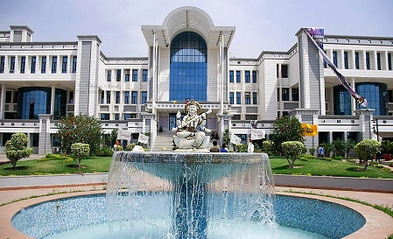
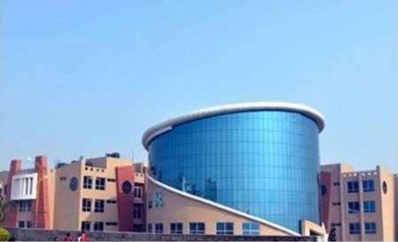



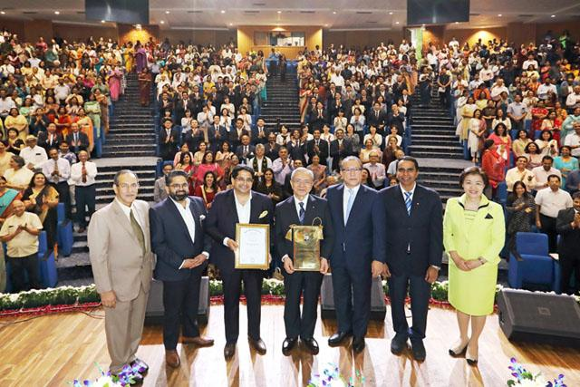
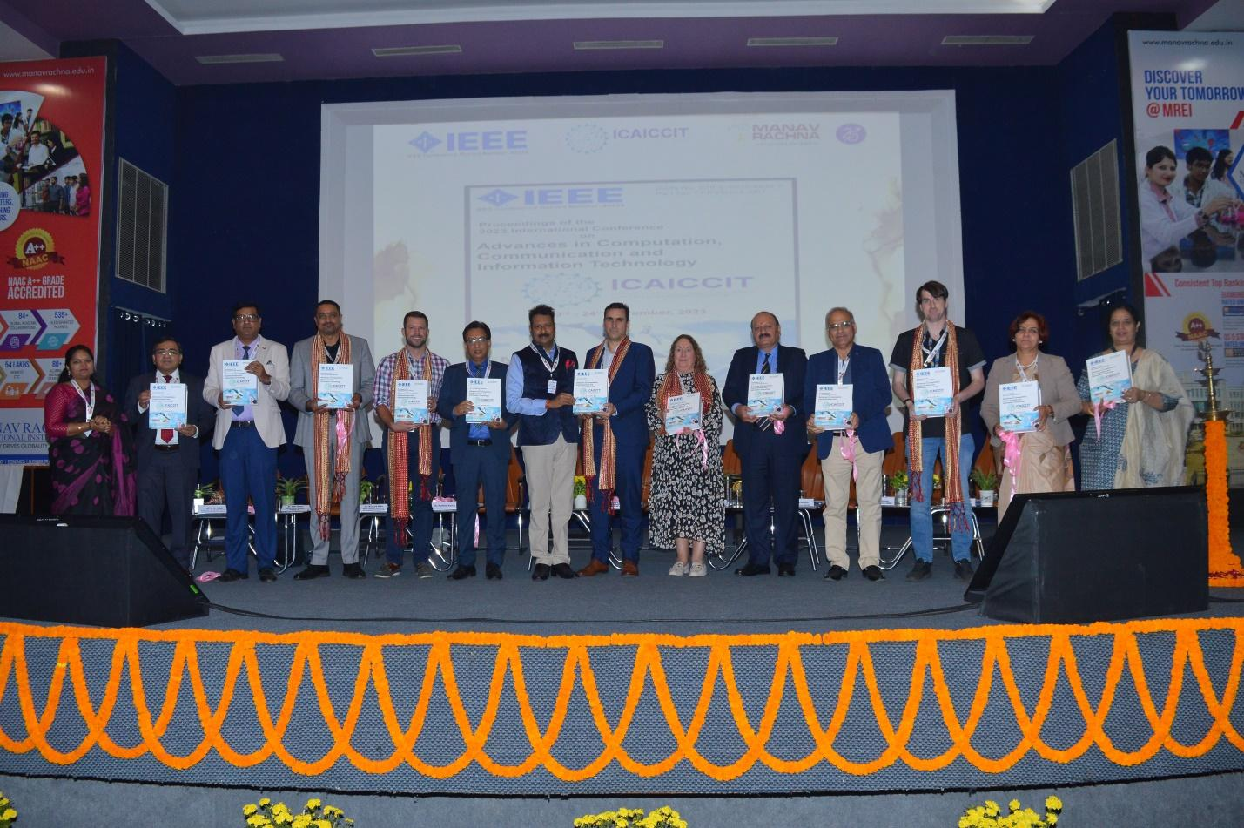

ICAICCIT - 2024 ( 2nd International Conference on Advances in Computation, Communication and Information Technology)
IEEE Delhi Section has agreed to be Technical Sponsor. (IEEE conference record number #64383)
28th and 29th November, 2024

Slide 2
Machine Learning-Based Calorie Burn Estimation for Enhanced Physical Activity Monitoring
ICAICCIT_528
Presented by Team members details
Santhiya S, Senthamarai M, Jayadharshini P, Akshay J, Juber B, Aneesh S
Akshay J, Juber B
Authors Name & Affiliation

Slide 3
Introduction
Estimate calories burned from fitness tracker data.
Helps users track fitness and health.
Uses activity type, heart rate, and duration.
Applies Linear Regression and XG Boost models.
Provides personalized fitness insights and supports health goals.

Slide 4
Problem Statements
Existing methods for calorie burn estimation lack accuracy.
Wearable devices provide generalized and limited insights.
Generic formulas fail to account for individual variability.
Precision in calorie estimation is crucial for health-conscious individuals.
Need for a data-driven, ML-based solution for accurate predictions.

Slide 5
Objectives
Develop a machine learning model to accurately estimate calorie burn.
Integrate individual-specific parameters for personalized predictions.
Leverage user activity data for real-time calorie tracking.
Enhance health monitoring with precise and actionable insights.
Provide a user-friendly interface for seamless interaction.

Slide 6
Literature Review
Authors | Title of the Paper | Journal Name | Year of Publication
Marte Nipas, Aimee G. Acoba, Jennalyn N. Mindoro, Mon Arjay F. Malbog, Julie Ann B. Susa, Joshua S. Gulmatico | Burned Calories Prediction using Supervised Machine Learning: Regression Algorithm | IEEE | 2022
Aziz, M. T., Sudheesh, R., Pecho, R. D. C., Khan, N. U. A., Ull, A., Era, H., & Chowdhury, M. A. | Calories Burnt Prediction Using Machine Learning Approach. | Current Integrative Engineering | 2023
Amol Kadam, Anurag Shrivastava, Sonali K. Pawar, Vinod H Patil, Jacob Michaelson, Ashish Singh. | Calories Burned Prediction Using Machine Learning | IEEE | 2023

Slide 7
Methodology
Collected data on physical activities, heart rate, duration, and calorie burn from fitness trackers.
Cleaned data by handling missing values, normalizing features, and encoding categorical variables.
Applied machine learning algorithms (Linear Regression and XGBoost) for calorie burn prediction.
Split the data into training and testing sets, using cross-validation for reliable model performance.
Evaluated model accuracy using MAE, RMSE, and R-squared, and optimized models for better predictions.

Slide 8
Result & Discussion
Regression | Mean Absolute Error (MAE)
Linear Regression | 8.3851
Decision Tree Regression | 3.343
XG Boost Regression | 1.4807
Ada boost Regression | 8.670
Support Vector Machine | 10.620.
XGBoost Regression achieved the lowest Mean Absolute Error (MAE) of 1.4807, indicating the best performance for calorie burn prediction among the models tested

Slide 9
Conclusion & Future Scope
Developed an efficient system for estimating calorie burn using advanced algorithms.
Leveraged accurate models to provide personalized insights for users.
Contributed to promoting healthier lifestyles with easy-to-use technology.
Incorporate real-time tracking with wearable device integration.
Expand functionality to include activity-specific and demographic-based estimations.

Slide 10
References
Nipas, M., Acoba, A. G., Mindoro, J. N., Malbog, M. A. F., Susa, J. A. B., & Gulmatico, J. S. (2022, March). Burned calories prediction using supervised machine learning: Regression algorithm. In 2022 Second International Conference on Power, Control and Computing Technologies (ICPC2T) (pp. 1-4). IEEE.
Aziz, M. T., Sudheesh, R., Pecho, R. D. C., Khan, N. U. A., Ull, A., Era, H., & Chowdhury, M. A. (2023). Calories burnt prediction using machine learning ap-proach. Current Integrative Engineering, 1(1), 29-36.
Kadam, A., Shrivastava, A., Pawar, S. K., Patil, V. H., Michaelson, J., & Singh, A. (2023, September). Calories Burned Prediction Using Machine Learning. In 2023 6th International Conference on Contemporary Computing and Informatics (IC3I) (Vol. 6, pp. 1712-1717). IEEE.

